Slide 1
Laws of Branding
Muhammad Saad 22L-7938
Asad Shafiq 22L-7932
Saad Amir 22L-79XX
Muhammad Talha 22L-79XX

Slide 2
Law of Name
In the long run a brand is nothing more than a name.

Slide 3

Short term success vs Long term success

Slide 4

Xerox
The first Plain-Paper Copier

Slide 5
Product VS Branding
The business community is divided on whether product development or branding is more important for business success.
Product campers believe that the quality of a product is more important than its brand name.
Branding campers believe that a strong brand can help a product succeed even if it is not the best on the market.

Slide 6
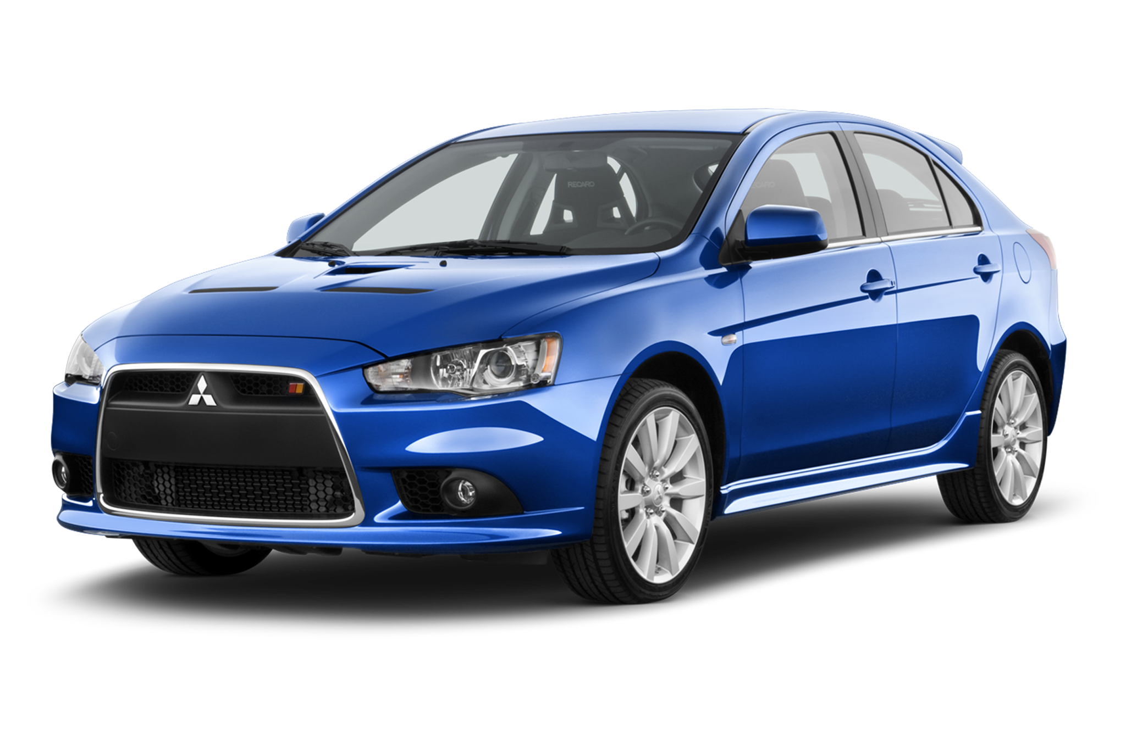


Slide 7
What Mitsubishi Makes?
Automobiles
Semiconductors
consumer electronics
Space Equipment

Slide 8


MUTSUI
Eight of the one hundred largest Japanese companies market products and services under the Matsushita name.
Matsushita
Eight of the one hundred largest Japanese companies market products and services under the Matsushita name.

Slide 9
Japan Vs America
 | Japan | America
Sales | $2.6 trillion | $3.6 trillion
Profit | 0.8% | 6.2%

Slide 10

Korea is in even worse shape
Korean companies had sales of $409 billion
combined net loss of 0.4 percent of sales.

Slide 11

Asia has branding problem
East Asia does not have a banking problem, a financial problem, a monetary problem, or a political problem. East Asia has a branding problem.

Slide 12
Law of Extensions
The easiest way to destroy a brand is to put its name on everything.

Slide 13

Pitfall of Line Extensions
Excessive line extension can negatively impact a brand's success.
The influx of numerous product variations, particularly in grocery and beverage industries, saturates the market.
Overcrowded shelves with unsold products hinder brand recognition.
The prevalence of line extensions (90% of new products) contributes to market saturation.

Slide 14
Empowering Retailers, Stifling Innovation
The overwhelming number of line extensions has empowered retailers to demand trade promotions, slotting fees, and return privileges from manufacturers.
This shift in power from manufacturers to retailers is largely attributed to line extension strategies.
Retailers can dictate shelf space pricing due to the abundance of product choices.
This approach not only hinders brand growth but also limits opportunities for new and innovative products.

Slide 15

The Need for Strategic Brand Management
The proliferation of line extensions is often driven by companies imitating competitors and copying successful products.
This strategy leads to market saturation with unnecessary line extensions, devoid of genuine innovation.
The beer industry serves as an example, where three major brands expanded to fourteen through line extension, without a corresponding increase in market share.

Slide 16
Prioritize Brand Strength over Line Extension:
Understanding consumer behavior is crucial to effective brand management.
Introducing a new brand may be a more strategic approach than line extension.
Line extensions often overlook core brand erosion and missed opportunities.
Companies should prioritize building strong, distinct brands instead of excessive line extension.

Slide 17
Thank You

